Slide 1
Analysis of Pikes Peak Runners
Mission Analytics Data Exercise
By Jordan Baldwin

Slide 2
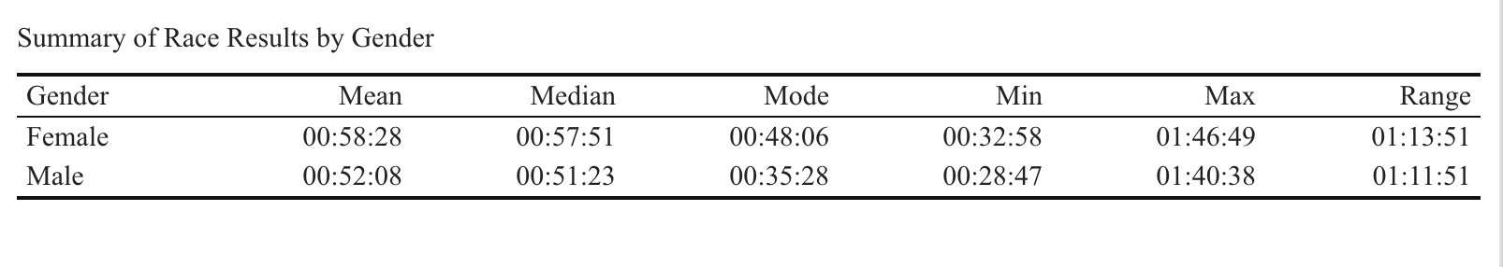
What are the mean, median, mode, and range of the race results for all racers by gender?
From this we can observe that males tended to be faster than the female racers by about 6 minutes. We can also see that it took racers between about 30 minutes to an hour and 15 minutes to complete the race, and use that to plan future races.

Slide 3
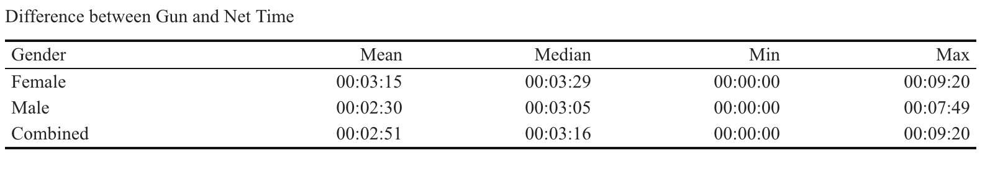
Analyze the difference between gun and net time race results.
Gun time is the amount of time it takes a runner from when the gun goes off to when they cross the finish line. Net time is the amount of time it takes from when they cross the start line to the finish line. Gun time is always longer than Net time.
Generally the male racers had a shorter difference between Gun and Net time, probably because they had faster times overall and were generally moving quicker to the start line.

Slide 4
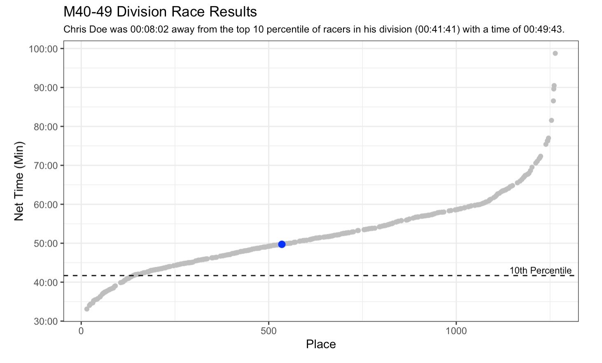
How much time separates Chris Doe from the top 10 percentile of racers of the same division?

Slide 5
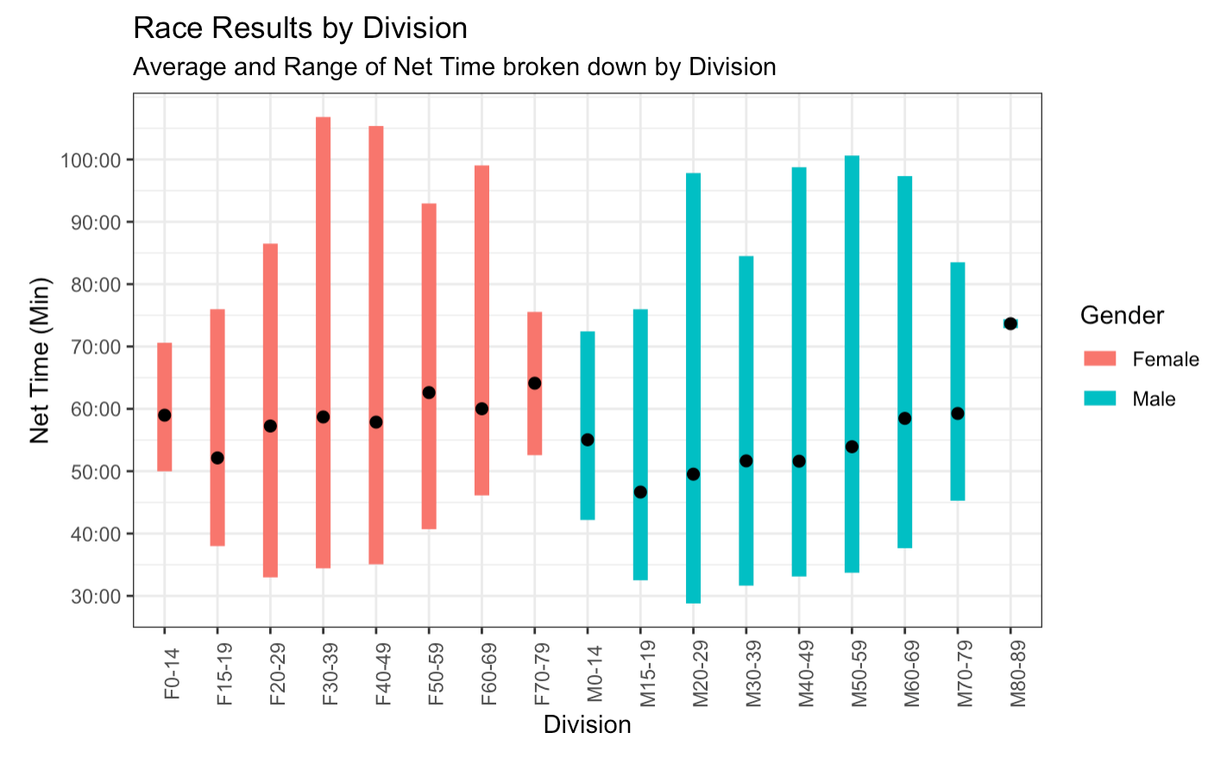
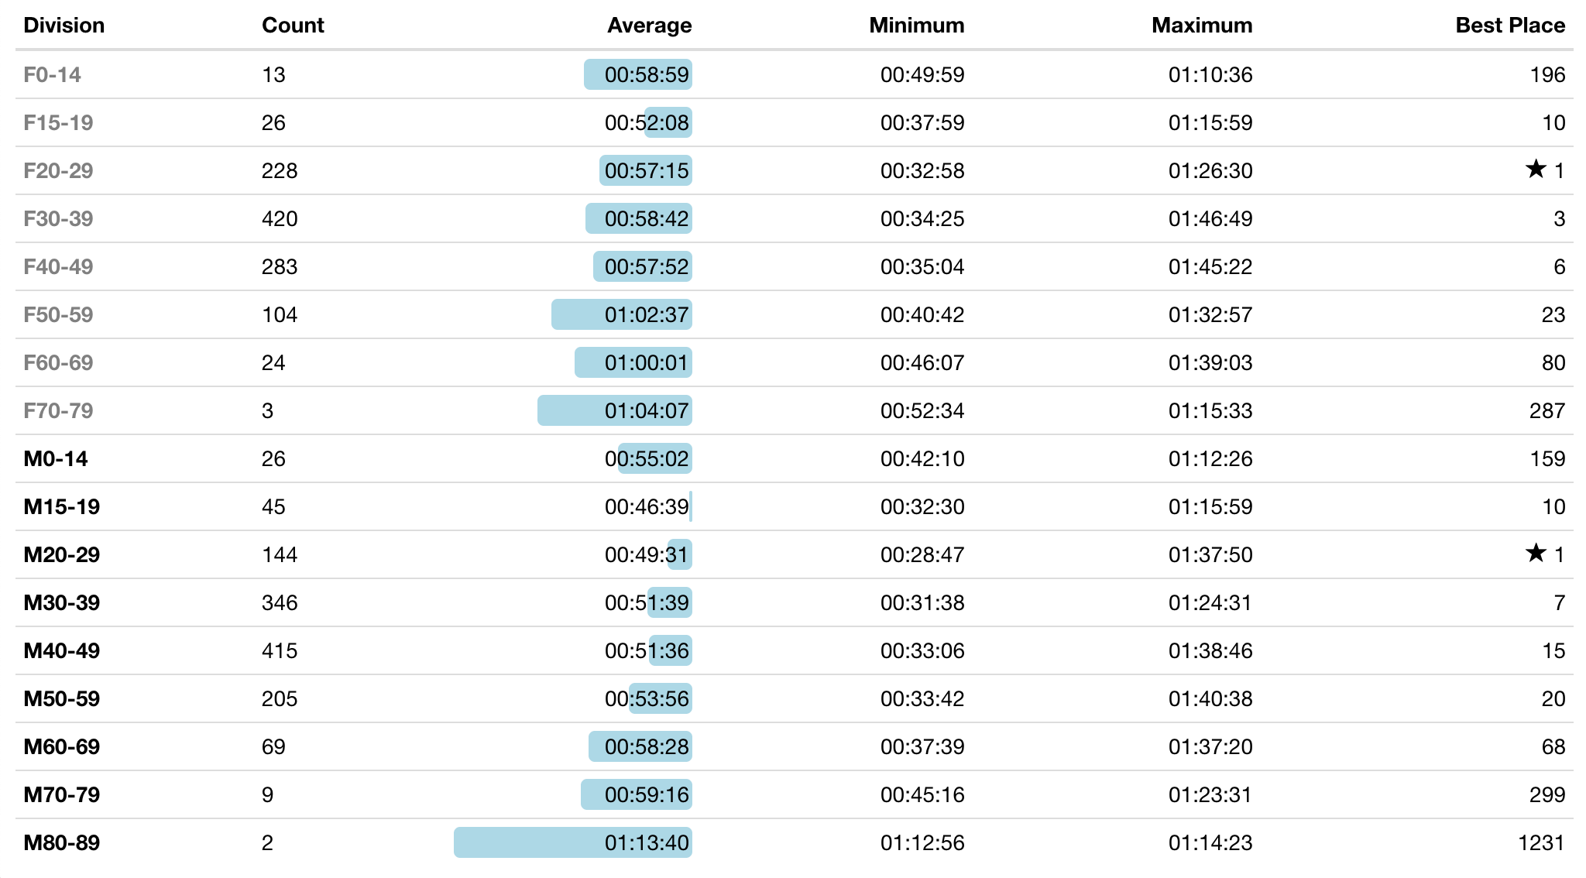
Compare the race results of each division.

